Slide 1
Individual Leadership Reflection Portfolio
Diksha Manwani
Notes:
Source: https://www.templateswise.com/modern-squares-powerpoint-template/

Slide 2
Contents
Personal Mission Statement
Differential Average
Leadership Style & LPI Assessment
Inspirational Leaders
Previous Experiences
Career Plan

Slide 3

Personal Mission Statement
My mission is to use my knowledge and skills to create positive change in the world by utilizing innovative solutions, working collaboratively with others, and advocating for those who are underserved or in need.

Slide 4
Leadership Style
As I see it…
Democratic + Transformational
I believe in creating an environment of collaboration and open communication while challenging the process and changing the status quo for the better
Fostering Accountability
I try to create an atmosphere of trust and respect among team members while fostering a sense of ownership and accountability
I believe that it is important to recognize and reward individual and team efforts since it serves as a source of motivation
Recognize & Reward

Slide 5
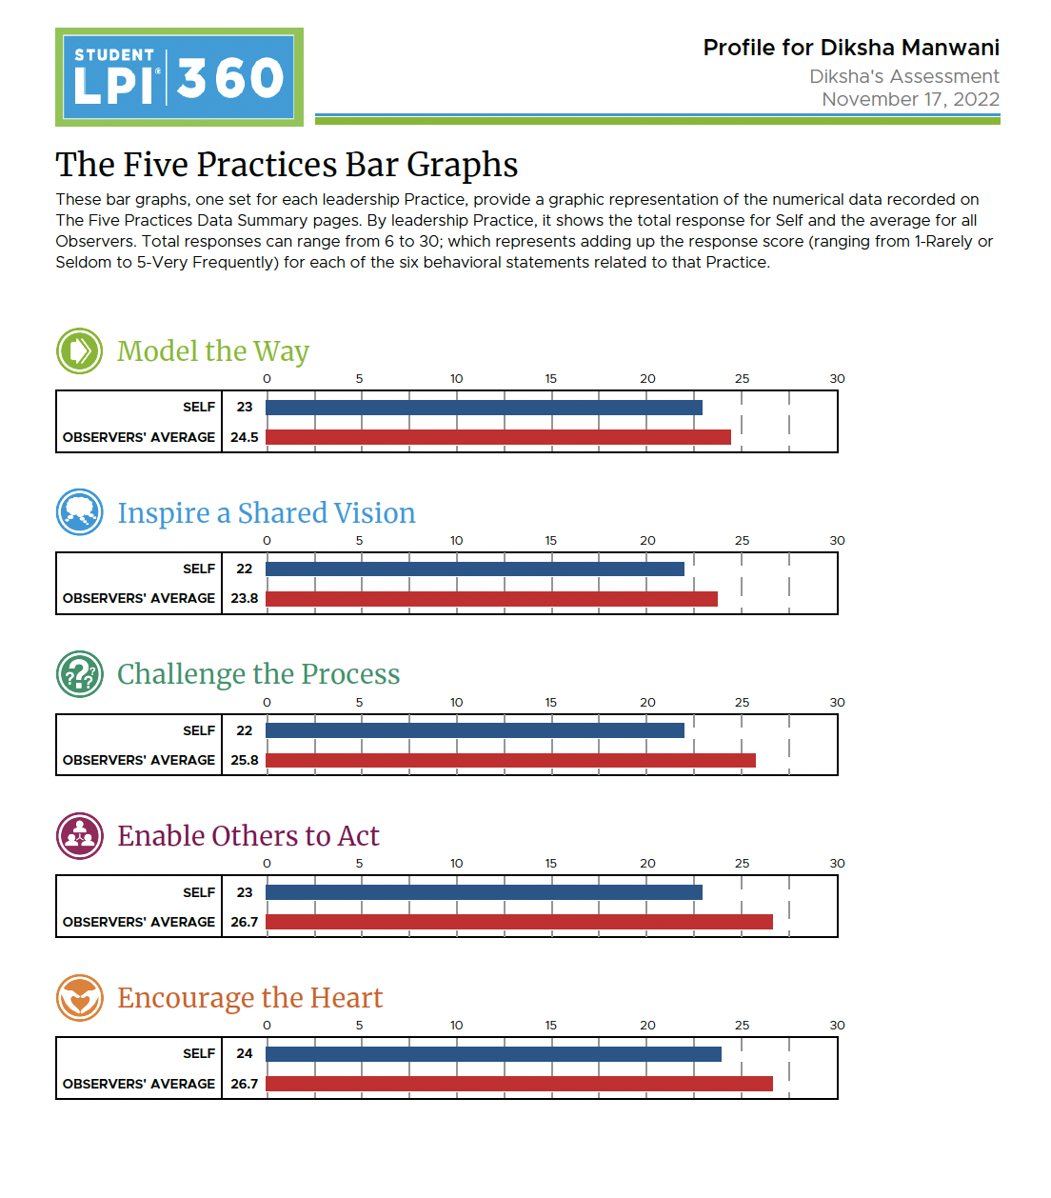
Leadership Style
As my peers see it (LPI)…
My Peers affirm a lot of the qualities I believed to have, like “Encouraging the Heart” which means maintaining a collaborative and inclusive environment and providing others with opportunities.
But some things did come as a surprise to me. I hoped to score better on some questions from “Inspired a Shared Vision”. The average score is more than my self-score but there is a huge difference in individual question scores for some questions. For example, I considered myself more upbeat and positive than my peers did. I also thought I am great at communicating the project's future, but my peers didn’t agree much.

Slide 6
LPI Assessment
My Strengths
My Weaknesses
Foster cooperative relationships
Underestimate Myself
Challenge skills and abilities
Talking about how the future could be better
Initiate experimenting
Aligns others with the decided principles and standards
Follow through on promises & demonstrates Commitment
Communicating the Vision
Express appreciation for people's contributions
A Little Moody

Slide 7
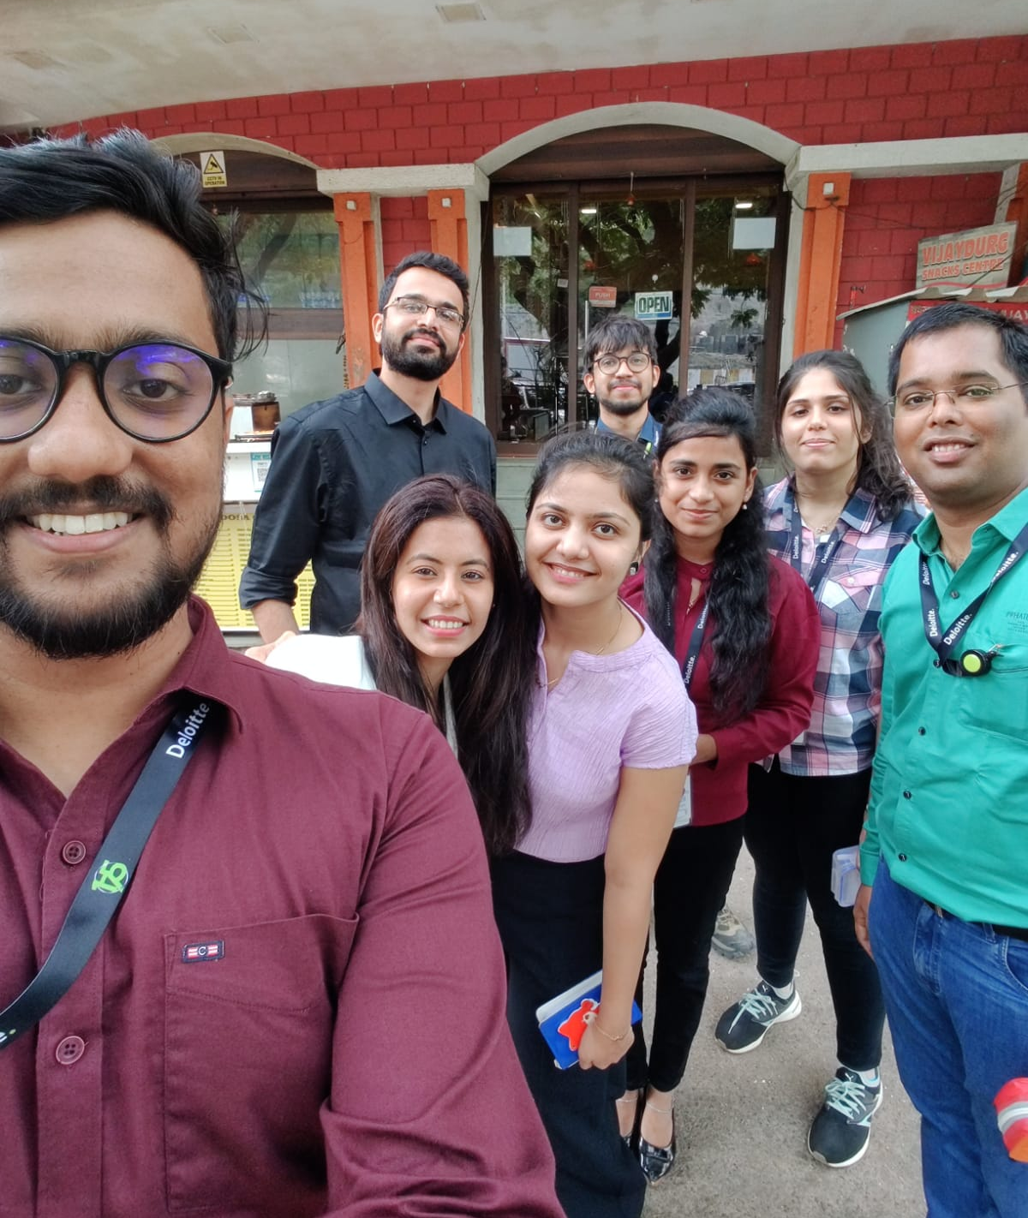
Previous Experiences
I don’t have one major incident that demonstrates my abilities, but some small ones
I used to host events like learning German and playing Scribble with my colleagues at my workplace to build an inclusive and fun environment, especially for the new team members.
The Strength here: Fostering cooperative relationships, Communicating effectively, and Networking
The Weakness here: Sometimes getting distracted from actual work
I sometimes worked 14 hours a day to get a job done. Once I did it so that my colleague can take a vacation.
The Strength here: Commitment to Work
The Weakness here: Underestimate already existing work and take on more without thorough thinking

Slide 8
Differential Average
I have a strong work ethic and a positive attitude, and I'm willing to go the extra mile to get the job done
What makes me unique is my combination of skills, interests, and experiences. I have a passion for learning and growing, and I'm constantly pushing myself to reach new heights
I'm creative and resourceful, and able to produce creative solutions to tricky problems. Also, I'm a great listener and an even better communicator, which makes me a valuable asset to any team

Slide 9
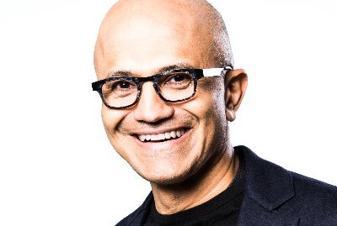
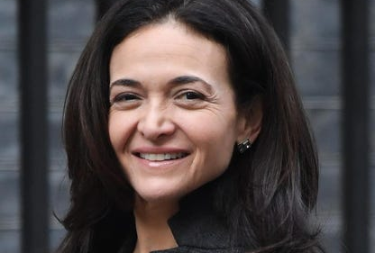
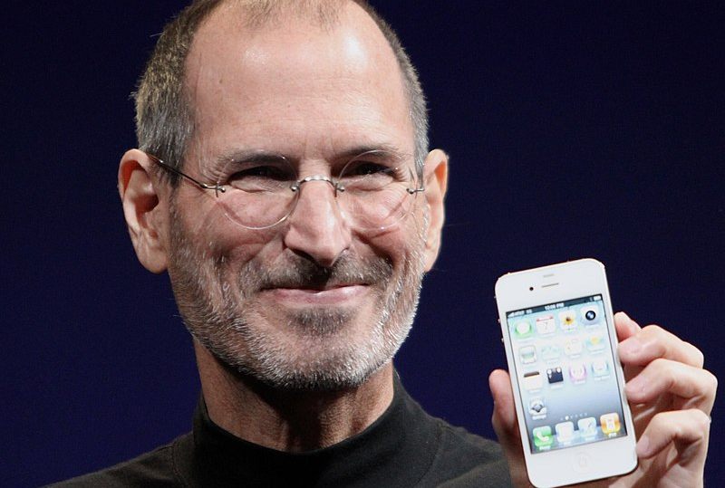
Inspirational Leaders
Satya Nadella, the CEO of Microsoft, is an inspiring leader who challenges the status quo. Under his leadership, Microsoft has become a leader in cloud computing, artificial intelligence, and machine learning. He has also pushed the company to innovate and embrace new technology, such as the open-source movement. The quality that I resemble him is “Challenge the Process”
Sheryl Sandberg, the Chief Operating Officer of Meta, has been a strong advocate for women's rights and has worked to encourage her team to embrace diversity and inclusion in their workplace. Sandberg is an example of a leader who has encouraged her team to take risks, think big and push the boundaries of what is possible. The quality that I resemble her is “Encourage the Heart”
Steve Jobs, the co-founder and CEO of Apple, was known for his commitment to innovation, creativity, and design. He was a leader who was passionate about technology and its potential to transform the lives of people. His approach to product design, marketing, and customer experience set the standard for the industry, and he was a key driving force behind many of the revolutionary products. The quality that I resemble him is “Commitment to Work”

Slide 10
Career Plan
Complete the degree and gain experience in the areas of Data Science and Data Analysis.
Take on more responsibility in my job role, such as leading and mentoring projects
Join a startup as an executive or technical lead
2022
2023
2024
2025
2026
2027
Begin working full-time in a data science or analytics role and build expertise in the field, while repaying the education loan!
Pursue a specialized certification in a specific domain and explore related domains like ML and AI
Focus on Social Work and give back to the community as much as possible

Slide 11
Thank You!
Notes:
Source: https://www.templateswise.com/modern-squares-powerpoint-template/

Slide 12
Template Source Unknown. (2020). Modern Squares PowerPoint Template and Google Slides. Templateswise.com. Retrieved December 10, 2022, from https://www.templateswise.com/modern-squares-powerpoint-template/

